Slide 1

Green Pace
Security Policy Presentation
Developer: Sarah Dowd
Notes:
Welcome to the Green Pace Secure Development Policy. Today I'll walk you through what's in the policy, how we test for the vulnerabilities it covers, and where I think we still have gaps.

Slide 2

OVERVIEW: DEFENSE IN DEPTH
Green Pace builds custom applications across many teams. Its Secure Development Policy gives every person who creates, deploys, or supports custom software one consistent set of rules: ten core security principles, ten C/C++ coding standards, encryption standards, and Triple-A (authentication, authorization, accounting) controls.
Why it was needed: consistent approaches must be maintained through uniformly defined, implemented, governed, and maintained policies, so security no longer depends on each team's judgment or any one reviewer's memory.
How it supports defense in depth: no single control is trusted to catch everything. A violation that slips past the developer's editor should be caught by the build, the pipeline, testing, or monitoring, and each standard is covered by at least two detection tools.
Notes:
Green Pace builds custom applications across a lot of teams, and until now each team has handled security a little differently. The Secure Development Policy fixes that. It gives everyone who creates, deploys, or supports custom software the same rules: ten core security principles, our C++ coding standards, encryption standards, and the Triple-A controls for authentication, authorization, and accounting.
Consistency is the reason it was needed. When policies are uniformly defined, implemented, governed, and maintained, security no longer depends on one team's judgment or one reviewer's memory.
It also supports defense in depth, the layered model in this illustration, which runs from physical security all the way down to the data itself. No single control is trusted to catch everything. If a flaw slips past the developer's editor, the build, the pipeline, testing, or monitoring should catch it, and each standard in the policy is covered by at least two detection tools.

Slide 3
THREATS MATRIX
Each coding standard was rated for severity, likelihood, and remediation cost. Those ratings set its priority score (P) and level (L1 is highest).
Five L1 standards are likely or probable: STD-003, 004, 005, 008, and 009.
No L1 standard is rated unlikely.
Likely / Probable · High (L1) STD-003 Null std::string (P18) STD-004 SQL injection (P18) STD-005 Allocation failures (P27) STD-008 Uninitialized reads (P12) STD-009 Raw memory comparison (P12) | Unlikely · High (L1) None: no L1 standard is unlikely.
Likely / Probable · Medium (L2) STD-002 Divide by zero (P6) STD-007 Unhandled exceptions (P6) STD-010 Freed memory use (P9) STD-011 Follow the principle of least privilege (P9) | Unlikely · Low (L3) STD-001 Out-of-range enum cast (P4) STD-006 Assertions (P1)
Notes:
This is the threats matrix. I rated each coding standard on severity, likelihood, and remediation cost. Those three ratings multiply into a priority score, P, and the score sets a level, where Level 1 is the highest.
Five standards land in Level 1, and all five are likely or probable. STD-003, creating a std::string from a null pointer, is P18. STD-004, SQL injection, is also P18. STD-005, memory allocation failures, is P27, the highest score in the policy. STD-008, reading uninitialized memory, and STD-009, comparing objects with a raw memory comparison, are both P12. The top-right box is empty because no Level 1 standard is unlikely. Anything severe enough to be Level 1 is also likely or probable.
Level 2 holds STD-002, divide by zero, and STD-007, unhandled exceptions, at P6, plus STD-010, freed memory use, and STD-011, least privilege, at P9. Level 3 holds STD-001, out-of-range enum casts, at P4, and STD-006, assertions, at P1. Those two are low severity and unlikely, so they get the lowest priority, but they're still required standards.

Slide 4
10 PRINCIPLES
Validate Input Data
  STD-001: Do not cast to an out-of-range enumeration value
  STD-002: Ensure division and remainder never divide by zero
  STD-003: Do not create a std::string from a null pointer
  STD-004: Prevent SQL injection
  STD-006: Use assertions for diagnostics, never for input validation
Heed Compiler Warnings
  STD-008: Do not read uninitialized memory
Architect and Design for Security Policies
  STD-007: Handle all exceptions
Keep It Simple
  STD-003: Do not create a std::string from a null pointer
  STD-008: Do not read uninitialized memory
  STD-009: Do not access object padding bits
  STD-010: Do not access freed memory
Default Deny
Adhere to the Principle of Least Privilege
  STD-004: Prevent SQL injection
Sanitize Data Sent to Other Systems
  STD-004: Prevent SQL injection
Practice Defense in Depth
  STD-005: Detect and handle memory allocation errors
  STD-007: Handle all exceptions
  STD-010: Do not access freed memory
Use Effective Quality Assurance Techniques
  STD-002: Ensure division and remainder never divide by zero
  STD-005: Detect and handle memory allocation errors
  STD-006: Use assertions for diagnostics, never for input validation
  STD-009: Do not access object padding bits
Adopt a Secure Coding Standard
Notes:
Every standard is tied back to one or more of the ten core security principles
Validate Input Data supports the most standards: STD-001, 002, 003, 004, and 006. An enum value, a divisor, a pointer, and a query string are all input that can't be trusted until it's been checked. Heed Compiler Warnings supports STD-008, because the compiler can flag an uninitialized read before the code ever runs. Architect and Design for Security Policies supports STD-007, since error handling has to be designed in from the start.
Keep It Simple supports STD-003, 008, 009, and 010. Simple, predictable memory handling leaves fewer ways to go wrong. Adhere to the Principle of Least Privilege and Sanitize Data Sent to Other Systems both support STD-004, because the database should only receive clean input and should run under a restricted account. Practice Defense in Depth supports STD-005, 007, and 010. Use Effective Quality Assurance Techniques supports STD-002, 005, 006, and 009, which are the kind of flaws testing and analysis catch well.
Two principles, Default Deny and Adopt a Secure Coding Standard, aren't mapped to a specific standard yet. I'll come back to that in the recommendations.

Slide 5
CODING STANDARDS
STD-005 Detect and handle memory allocation errors
STD-003 Do not create a std::string from a null pointer
STD-004 Prevent SQL injection
STD-008 Do not read uninitialized memory
STD-009 Do not access object padding bits (no memcmp on objects)
STD-010 Do not access freed memory
STD-011 Follow the principle of least privilege
STD-002 Ensure division and remainder never divide by zero
STD-007 Handle all exceptions
STD-001 Do not cast to an out-of-range enumeration value
STD-006 Use assertions for diagnostics, never for input validation
Ranking system: Severity (Low 1, Medium 2, High 3) × Likelihood (Unlikely 1, Probable 2, Likely 3) × Remediation ease (High cost 1, Medium 2, Low 3) = priority score P1 to P27.
Levels: L1 = P12 and above (high), L2 = P6 to P9 (medium), L3 = P1 to P4 (low). L1 and L2 findings block the build. Example: STD-005 is High severity, Likely, and Low cost, so P27 (L1). STD-006 is Low, Unlikely, and High cost, so P1 (L3).
Notes:
These are the coding standards, and here's how I prioritized them. Priority is severity times likelihood times remediation ease. Severity runs from low at 1 to high at 3. Likelihood runs from unlikely at 1 to likely at 3. Remediation ease is scored so cheap fixes rank higher: high cost is 1 and low cost is 3. That gives scores from P1 to P27. Level 1 is P12 and above, Level 2 is P6 to P9, and Level 3 is P1 to P4. Level 1 and Level 2 findings block the build. STD-005 is high severity, likely, and cheap to fix, so it scores 27. STD-006 is low severity, unlikely, and expensive to fix, so it scores 1. I'll go through them in priority order, with the reason for each and an example of when it applies.
STD-005, detect and handle memory allocation errors. If an allocation fails and we don't check, the program dereferences a bad pointer or crashes, and an attacker can use that for denial of service. It applies any time a buffer size comes from user input, like a file upload. Catch std::bad_alloc, or check the result, and fail safely.
STD-003, don't create a std::string from a null pointer. That's undefined behavior and usually a crash. It applies to functions like std::getenv, which return null when the variable isn't set. Check before you build the string.
STD-004, prevent SQL injection. Attacker input changes the meaning of the query and can expose or alter a whole table. It applies to any login or lookup that builds a query from user input. Use parameterized queries. You'll see this in the unit tests.
STD-008, don't read uninitialized memory. The value is whatever was left there, so behavior is unpredictable and old data can leak. It applies to something as simple as a counter declared without a value. Initialize at declaration.
STD-009, don't access object padding bits. Using memcmp on an object compares padding bytes that have no defined value, so two equal objects can compare as different. It applies when comparing structs. Compare member by member instead.
STD-010, don't access freed memory. If something else reuses that memory, an attacker may control what the stale pointer reads or writes. It applies to a pointer kept in a list after the object was deleted. Use smart pointers and RAII, and set raw pointers to nullptr after delete.
STD-011, follow the principle of least privilege. A compromised component can only do what its account allows. It applies to the database account the application uses, which should have access to the tables it needs and nothing more.
STD-002, ensure division never divides by zero. That's undefined behavior and a crash. It applies to something like an average computed over an empty list. Check the divisor first.
STD-007, handle all exceptions. An uncaught exception terminates the program, which an attacker can use as a denial of service. It applies to code parsing malformed input. Catch at the boundary, log it, and fail safely.
STD-001, don't cast to an out-of-range enumeration value. The result is unpredictable, and later switches or array lookups misbehave. It applies when a number from a user is cast to an enum, like a menu choice. Range-check before the cast.
And STD-006, use assertions for diagnostics, never for input validation. Assertions are compiled out of release builds, so a check written as an assertion disappears in production. Use a real if statement for validation.

Slide 6
ENCRYPTION POLICIES
Encryption at rest (stored data): disks, databases, backups, removable media, endpoints, and app-stored credentials are unreadable without the key. Applies to all confidential-or-higher data, from write until secure destruction. Use full-disk encryption, field-level encryption for sensitive columns, and AES-256 or an approved equivalent. Keys stay in a managed key store or HSM, never in code or config. Passwords are salted hashes, not encrypted.
Encryption in flight (data moving between systems): TLS 1.2 or higher with validated certificates for all non-public data, including internal traffic. No disabling certificate checks and no fallback to HTTP, FTP, or Telnet. Remote admin and file transfer use SSH, SFTP, or VPN. Database connections are encrypted. Prevents eavesdropping, tampering, and impersonation; supports STD-004.
Encryption in use (data decrypted in memory): keep sensitive values only as long as needed, zeroize them with a method the compiler cannot optimize away, and never write them to logs, crash dumps, or swap. Use hardware-backed protected environments for highly sensitive data where available. Use-after-free (STD-010) and uninitialized reads (STD-008) can expose plaintext that the other layers protected.
Notes:
The encryption policy covers data in three states.
Encryption at rest protects stored data: disks, databases, backups, removable media, endpoints, and credentials stored by an app. It applies to all confidential-or-higher data from the moment it's written until it's securely destroyed. We use full-disk encryption, field-level encryption for sensitive columns, and AES-256 or an approved equivalent. Keys stay in a managed key store or HSM, never in code or config. Passwords are different: they're stored as salted hashes, not encrypted, because we never need to read them back. The USERS table in my unit tests has a password column. In production, that column has to hold salted hashes, never plain text. The example for why is a lost backup drive. If it's encrypted, the loss is an inconvenience instead of a breach.
Encryption in flight protects data moving between systems. It requires TLS 1.2 or higher with validated certificates for all non-public data, including internal traffic. Certificate checks can't be disabled, and there's no fallback to HTTP, FTP, or Telnet. Remote admin and file transfer use SSH, SFTP, or VPN, and database connections are encrypted. That prevents eavesdropping, tampering, and impersonation, and it supports STD-004 because an attacker on the network can't alter queries on their way to the database.
Encryption in use covers data that's decrypted in memory. Keep sensitive values only as long as needed, zero them out with a method the compiler can't optimize away, and never write them to logs, crash dumps, or swap. Use hardware-backed protected environments for highly sensitive data where they're available. This is where our coding standards matter, because use-after-free, STD-010, and uninitialized reads, STD-008, can expose plaintext that the other two layers protected.

Slide 7
TRIPLE-A POLICIES
Authentication (who you are): unique identities only, no shared or generic accounts. Sign in through the central directory (Active Directory) with strong passphrases stored as salted hashes. MFA for administrators, remote access, production data, and the build pipeline. Service accounts use managed secrets. Every login, successful or failed, is recorded.
Authorization (what you may do): role-based groups under least privilege, never per-person grants. New users and access changes need a documented request and manager approval. Access is removed immediately on a role change or departure, and privileged access is reviewed quarterly. Enforced on every request; database queries run under a restricted account.
Accounting (what happened): logs carry a timestamp, identity, action, and outcome, and cover user logins, database changes, new users, access-level changes, and files accessed. Logs go to a central, access-controlled store that administrators cannot quietly edit, and are reviewed on a schedule and on suspicious-pattern alerts.
Notes:
The encryption policy covers data in three states.
Encryption at rest protects stored data: disks, databases, backups, removable media, endpoints, and credentials stored by an app. It applies to all confidential-or-higher data from the moment it's written until it's securely destroyed. We use full-disk encryption, field-level encryption for sensitive columns, and AES-256 or an approved equivalent. Keys stay in a managed key store or HSM, never in code or config. Passwords are different: they're stored as salted hashes, not encrypted, because we never need to read them back. The USERS table in my unit tests has a password column. In production, that column has to hold salted hashes, never plain text. The example for why is a lost backup drive. If it's encrypted, the loss is an inconvenience instead of a breach.
Encryption in flight protects data moving between systems. It requires TLS 1.2 or higher with validated certificates for all non-public data, including internal traffic. Certificate checks can't be disabled, and there's no fallback to HTTP, FTP, or Telnet. Remote admin and file transfer use SSH, SFTP, or VPN, and database connections are encrypted. That prevents eavesdropping, tampering, and impersonation, and it supports STD-004 because an attacker on the network can't alter queries on their way to the database.
Encryption in use covers data that's decrypted in memory. Keep sensitive values only as long as needed, zero them out with a method the compiler can't optimize away, and never write them to logs, crash dumps, or swap. Use hardware-backed protected environments for highly sensitive data where they're available. This is where our coding standards matter, because use-after-free, STD-010, and uninitialized reads, STD-008, can expose plaintext that the other two layers protected.

Slide 8
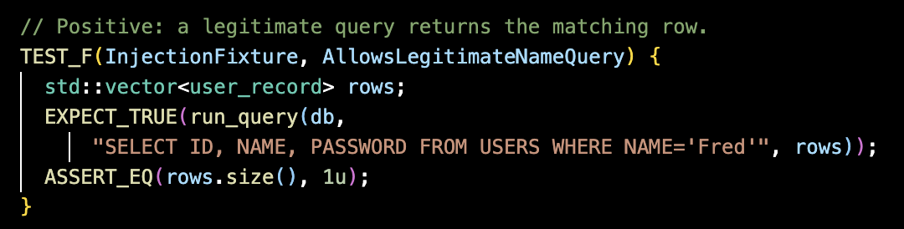
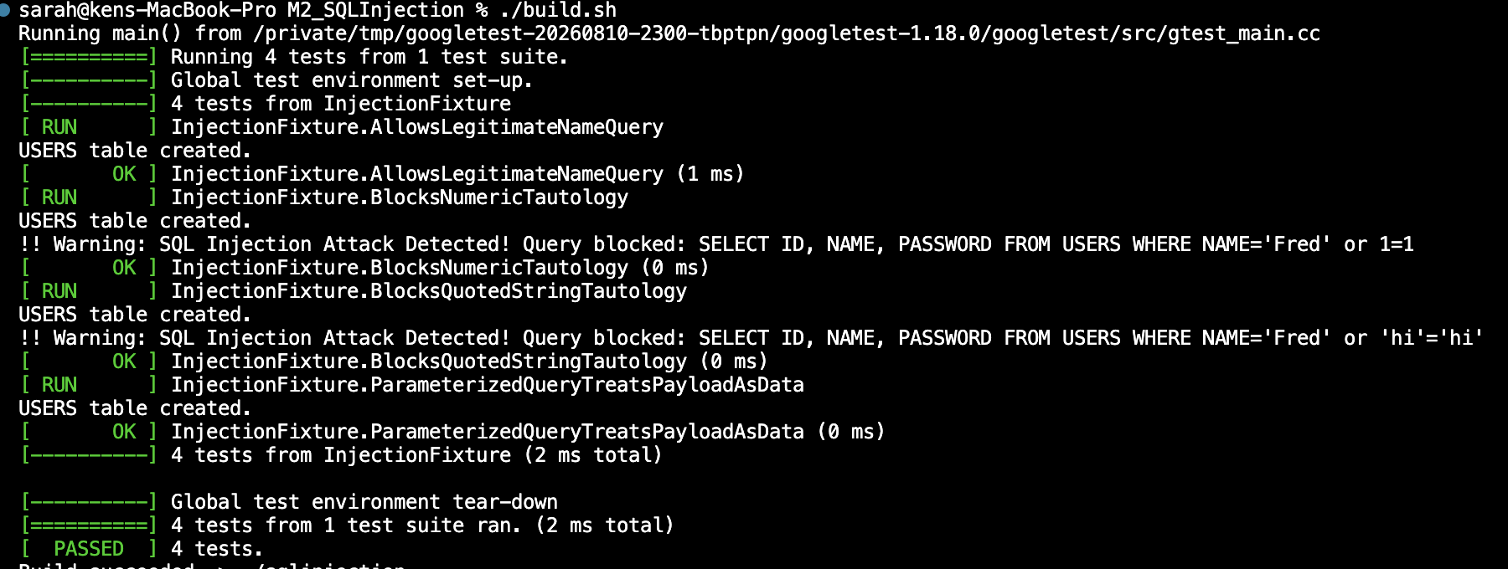
Unit Testing: Allows Legitimate Name Query
Notes:
Now the unit testing. These four slides come from my SQL injection exercise, written with Google Test, a C++ unit testing framework. A unit test checks one small behavior automatically and repeatably, so every time the code changes we find out right away whether a rule still holds. Each test runs in a fixture called InjectionFixture that builds a fresh USERS table.
This first one is a positive test. It runs a legitimate query, name equals Fred, and asserts that exactly one row comes back. It matters because a security control that breaks normal use gets turned off. In the output you can see RUN, then OK, in 1 millisecond.
To take it further, I'd add more legitimate cases, like a name that doesn't exist, which should return zero rows, and names with apostrophes like O'Brien, because a naive filter might block those by mistake.

Slide 9
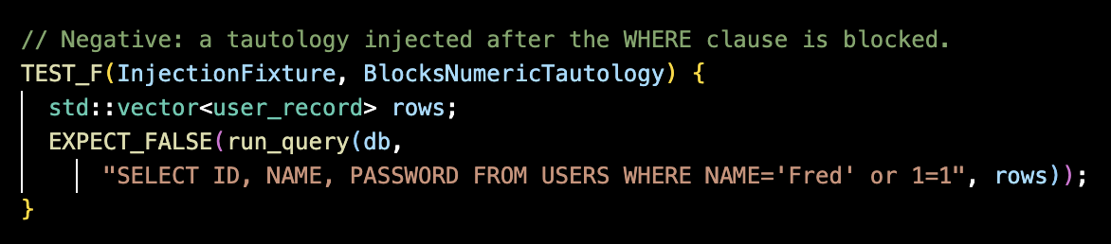
Unit Testing: Blocks Numeric Tautology
Notes:
This is the first negative test. The attacker adds or 1=1 after the WHERE clause. Since 1=1 is always true, an unprotected query would return every row in the table, including every password. The test uses EXPECT_FALSE, meaning run_query must refuse it. The output shows the warning, SQL Injection Attack Detected, Query blocked, and then OK.
To take it further, I'd test more payload shapes: UNION SELECT, comment sequences, stacked statements after a semicolon, and different casing and spacing, because pattern-based defenses get bypassed by small variations.

Slide 10
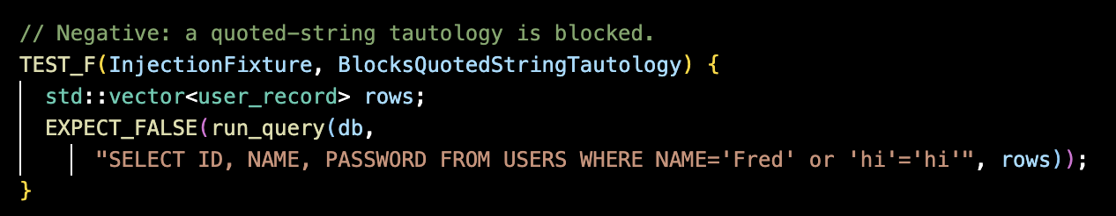
Unit Testing: Blocks Quoted String Tautology
Notes:
Same attack, different shape. Instead of 1=1, the payload is the quoted string 'hi' equals 'hi', which is also always true. This test proves the defense isn't just looking for the literal text 1=1. It blocked the query again, and the test passed in 0 milliseconds.
To take it further, I'd turn this into a data-driven test using Google Test's value-parameterized tests, so adding a new payload is one line. I'd also feed it from a fuzzer, so we find the variations before an attacker does.

Slide 11
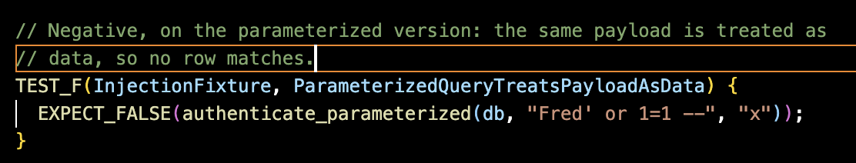
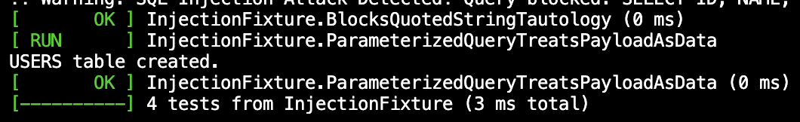
Unit Testing: Parameterized Query Treats Payload As Data
Notes:
This last test is the real fix. Blocking known attack patterns is detection. Parameterized queries remove the problem. The authenticate_parameterized function passes the name and password to SQLite as bound values, using a prepared statement, so the payload Fred' or 1=1 -- is just a string. It's compared against the name column, no user has that name, no row matches, and the function returns false.
The summary line shows all four tests in InjectionFixture passed in 3 milliseconds total. To take it further, I'd run this suite in the pipeline on every commit so a failure blocks the build, write a test like this for every function that touches the database, and keep the pattern-blocking as a second layer that alerts us, with parameterized queries as the primary control.

Slide 12

AUTOMATION SUMMARY
Notes:
This diagram shows where security automation fits in the DevSecOps flow. Pre-production is on the left, production is on the right, and the Dev, Sec, and Ops gears in the middle show that security sits between development and operations instead of at the end.
In pre-production, Assess and plan takes in new threats and prioritizes the backlog. Design is where we apply security best practices like OWASP. Build is where the compiler runs, on every compile, with warnings treated as errors, and where we use trusted repositories and secure open-source usage. Verify and test is where vulnerability scanning, static analysis, and security testing run on every commit, and where builds are digitally signed. That's also where my unit tests run.
In production, Transition and health check covers secure configuration and penetration testing before deployment. Monitor and detect covers log collection, alerting, and intrusion detection. Respond covers blocking attacks, turning off services, and rolling back. Maintain and stabilize returns us to a known good state, and what we learn goes back into Assess and plan.

Slide 13
TOOLS
DevSecOps pipeline: Green Pace already runs a DevOps pipeline. The policy adds security checks at the stage where each is cheapest to run, instead of a separate review at the end.
Assess and plan: threats matrix sets the backlog order; vulnerability and threat intelligence feeds correlated with the code base
Design: OWASP best practices; security tests written first
Build: IDE security plugins; compiler warnings (-Wall -Wextra -Wpedantic) as errors; Clang -Wuninitialized and Clang Static Analyzer (STD-008, STD-010); Cppcheck zerodiv (STD-002); trusted repositories and software composition analysis
Verify and test (every commit): Polyspace Bug Finder R2025b, Parasoft C/C++test 2026.1, CodeQL 2.27.2. The build fails on any L1 or L2 finding. Unit tests, integration tests, input fuzzing, digitally signed builds
Transition and health check: secure configuration; penetration testing
Monitor and detect: runtime monitoring; signature and integrity checks
Respond: web application firewall (WAF); roll back
Maintain and stabilize: return to a known good state; feed findings back into Assess and plan
Notes:
Green Pace already runs a DevOps pipeline, so the policy doesn't add a separate security review at the end. It adds checks at the stage where each is cheapest to run, using the stages from the diagram on the last slide.
Assess and plan: we prioritize the backlog with the threats matrix, and vulnerability and threat intelligence feeds are correlated with our code base. Design: we apply security best practices like OWASP and write the security tests first.
Build is where most of the code-level tools run. We use IDE security plugins and compiler warnings with -Wall, -Wextra, and -Wpedantic, treated as errors. Clang's -Wuninitialized and the Clang Static Analyzer catch STD-008 and STD-010, and Cppcheck's zerodiv check catches STD-002. We also pull from trusted repositories and run software composition analysis on third-party libraries.
Verify and test runs on every commit. Polyspace Bug Finder R2025b, Parasoft C/C++test 2026.1, and CodeQL 2.27.2 do the static analysis, and the build fails on any Level 1 or Level 2 finding. Unit tests, integration tests, and input fuzzing exercise the error paths, and builds are digitally signed so only reviewed, scanned code can deploy.
Transition and health check covers secure configuration and penetration testing before go-live. In production, Monitor and detect uses runtime monitoring and signature and integrity checks. Respond uses a web application firewall to block attacks, and rollback if we need it. Maintain and stabilize returns us to a known good state, and what we learn feeds back into Assess and plan.

Slide 14
RISKS AND BENEFITS
Act now: every commit is checked automatically at the cheapest stage. Gains: lower remediation cost, the same enforcement on every commit, no reliance on one reviewer's memory, and a consistent audit record.
Wait: the five L1 standards (STD-003, 004, 005, 008, 009) are likely or probable. Without automated enforcement, the most severe and most probable failures fall to manual review.
Risks of this strategy: no single tool is trusted, but coverage is partial. Five standards (STD-003, 005, 007, 008, 010) are rated only partially covered by at least one tool. Polyspace is the detection tool in 9 of 10 standards, so it is a single point of failure for most rules.
Where it is lacking: no automated checks for encryption or Triple-A controls, and no defined log review frequency.
Steps: (1) make L1 and L2 findings block the build on every commit; (2) add tests or manual checks for partially covered rules; (3) add an automated check for encryption settings such as TLS version and certificate validation; (4) set a log review cadence.
Notes:
Here's the case for acting now versus waiting. If we act now, every commit is checked automatically at the cheapest stage. That means lower remediation cost, the same enforcement on every commit, no reliance on one reviewer's memory, and a consistent audit record.
If we wait, the five Level 1 standards, STD-003, 004, 005, 008, and 009, are likely or probable, and without automated enforcement the most severe and most probable failures fall to manual review. That's not hypothetical. In 2015, TalkTalk's website was breached through SQL injection, personal data for 156,959 customers was accessed, and the UK regulator fined the company £400,000 (Jackson, 2016). That's exactly the failure STD-004 exists to prevent.
This strategy has risks too. No single tool is trusted, but coverage is partial. Five standards, STD-003, 005, 007, 008, and 010, are only partially covered by at least one tool. Polyspace is a detection tool for nine of the ten standards, so it's a single point of failure for most rules. And the policy is lacking in two places: there are no automated checks for encryption or Triple-A controls, and no defined log review frequency.
So here are the steps, in order. One, make Level 1 and Level 2 findings block the build on every commit. That's the cheapest step and covers the highest-scoring risks. Two, add tests or manual checks for the partially covered rules. Three, add an automated check for encryption settings, like TLS version and certificate validation. Four, set a log review cadence.

Slide 15
RECOMMENDATIONS
Principles 5 (Default Deny) and 10 (Adopt a Secure Coding Standard) are not mapped to any standard. Map Default Deny to Triple-A authorization.
Automated detection covers code only. No tool or check enforces the encryption or Triple-A policies.
Five standards are partially covered by their tools (STD-003, 005, 007, 008, 010), so they need added tests or manual review.
The accounting policy requires log review on a regular schedule but does not define the frequency.
STD-004 is drawn from a Java standard (IDS00-J) because no CERT C++ rule covers SQL injection. Note this in the policy and consider a custom CodeQL query.
Notes:
These are the gaps I found when I reviewed the policy against itself.
First, principles 5 and 10, Default Deny and Adopt a Secure Coding Standard, aren't mapped to any standard. I'd map Default Deny to the Triple-A authorization policy, since access should be denied unless a role explicitly grants it. Adopting a secure coding standard is really what the policy itself does, and I'd state that link explicitly.
Second, automated detection covers code only. No tool or check enforces the encryption or Triple-A policies. Third, five standards, STD-003, 005, 007, 008, and 010, are only partially covered by their tools, so they need added tests or manual review. Fourth, the accounting policy requires log review on a regular schedule but doesn't define the frequency, so it needs one.
Fifth, STD-004 comes from a Java standard, IDS00-J, because there's no CERT C++ rule for SQL injection. I'd note that in the policy and consider writing a custom CodeQL query so we can enforce it automatically in C++. Looking ahead, the policy is already reviewed annually, and I'd use that review to add standards whenever threat intelligence shows a new pattern.

Slide 16
CONCLUSIONS
Adopt all ten coding standards as the baseline, enforced in code review and in the pipeline.
Start with the L1 standards: STD-003, 004, and 005 (likely), then STD-008 and 009 (probable). Each one blocks the build.
Prevent dangling pointers with clear ownership (smart pointers and RAII) and set pointers to nullptr after delete (STD-010).
Keep the input checks: range checks before enum casts (STD-001) and zero checks before division (STD-002).
Pair the coding standards with the encryption and Triple-A policies so enforcement continues after code reaches production.
Notes:
To wrap up. Adopt all ten coding standards as the baseline, enforced in code review and in the pipeline. Start with the Level 1 standards: STD-003, 004, and 005, which are likely, then STD-008 and 009, which are probable. Each one should block the build.
Prevent dangling pointers with clear ownership, using smart pointers and RAII, and set pointers to nullptr after delete, which is STD-010. Keep the input checks too: range checks before enum casts, STD-001, and zero checks before division, STD-002.
Finally, pair the coding standards with the encryption and Triple-A policies, so enforcement continues after the code reaches production. Defense in depth only works if every layer is there. Thanks for listening.

Slide 17
REFERENCES
Carnegie Mellon University, Software Engineering Institute. (n.d.). SEI CERT C++ coding standard. https://wiki.sei.cmu.edu/confluence/display/cplusplus
Carnegie Mellon University, Software Engineering Institute. (n.d.). SEI CERT Oracle coding standard for Java: IDS00-J. Prevent SQL injection. https://wiki.sei.cmu.edu/confluence/display/java
The MathWorks, Inc. (n.d.). Polyspace Bug Finder: CERT C++ INT33-C. https://www.mathworks.com/help/bugfinder/ref/certcruleint33c.html
SQLite Consortium. (n.d.). Prepared statements (sqlite3_prepare_v2). https://www.sqlite.org/c3ref/prepare.html
LLVM Project. (n.d.). Clang static analyzer. https://clang-analyzer.llvm.org/
Cppcheck Team. (n.d.). Cppcheck: A tool for static C/C++ code analysis. https://cppcheck.sourceforge.io/
GitHub. (n.d.). CodeQL documentation. https://codeql.github.com/docs/
Dowd, S. (2026). Green Pace secure development policy (Version 3.2) [Internal policy document].
Notes:
My references are on the screen for anyone who wants to read further. They include the SEI CERT C++ coding standard, the CERT Java standard for SQL injection, the documentation for Polyspace, SQLite, Clang, Cppcheck, and CodeQL, and the Green Pace Secure Development Policy itself.

